Slide 1
HR Part II
Lesson 03: Route maps, rating scale, integration and Calibration

Slide 2
Lesson Objectives
After completing this lesson, participants will be able to -
Understand the rating scale
Understand the route maps
Understand Calibration in Performance Management
Performance Management and Goal Management Integration

Slide 3
Rating Scales
To create a form template, you technically need a rating scale. A rating scale is a tool used during the evaluation process to quantify a reviewer’s perspective on the employee’s performance.
Some customers no longer want to use rating but can still use performance forms. The rating scale will need to be defined in the template and you will not select the checkbox include the ability to rate in the ratable sections of the form template.
You can use an existing rating scale, or create a new one. The default rating scale contains 5 points, with 1 being the lowest rating and 5 is the highest. If the client wants, you can reverse the scale in Provisioning. Once the scale is reversed, however, it applies to all rating scales in all performance forms. This is a system-wide setting that also affects reports.
Note:
It is recommended that the customer use a 5–point rating scale.

Slide 4
Rating Scale Options
Scale Type Advantages and Disadvantages
Most of the time, rating scales will contain 3, 4, 5 or 7 points but we can configure the rating scales with as many points as the customer needs. However, it is recommended that a 5–point scale be used.
Scale Type | Advantages and Drawbacks
7–Point Scale | This type of scale may offer too much differentiation, as scores are too close to be of much value.
5–Point Scale | This type of scale contains a midpoint and allows for the most useful level of differentiation.
4–Point Scale | This type of scale lacks a neutral midpoint, and so evaluations tend to be artificially skewed towards one end of the scale or the other.
3–Point Scale | This type of scale does not provide enough differentiation, which often leads to inaccuracies and to too many neutral ratings.

Slide 5
Rater Training
Effective rater training can reduce the need for formal calibration. It is therefore best practice to encourage customers to host training sessions for all raters before the review cycle starts, to ensure everyone is rating employees on the same scale.
The rating scale should include behaviorally-specific examples of performance at each performance level. Raters should first rate the performance examples individually. Then, all raters rate the same examples collectively, so each rater gets an idea of whether they are being too lenient or strict in their rating of employee performance. After calibrating their ratings with the group using specific examples of performance, easy raters can tighten up their scores, and hard raters can loosen theirs.

Slide 6
Route Maps
Route maps establish the workflow and steps that users follow during the performance review process. They specify the order in which a form moves from one user to another, and what actions users can take at each step in the process.
Some aspects of form permissions are built at the template level. Several form templates can be associated with one route map.
When completing a performance review, the end user can view the route map for the form. The end user can see who the next recipient of the form is, and can forward the form to the next step when they have completed their part of the review.

Slide 7
Route Maps - An Example
You can develop route maps with unique sets of steps so that they follow the customer’s processes. Consider the following example:
Ed Employee’s end-of-year performance review process begins with his self-evaluation. Ed uses the performance review form to update the status of each of his goals, add comments, assess his strengths, and identify areas for development.
Ed’s manager, Manny Manager, receives Ed’s self-evaluation, reviews it, and then conducts his own evaluation of Ed’s performance on goals and competencies.
Ed and Manny meet to discuss the evaluation. This includes reviewing and giving feedback on Ed’s performance, and identifying Ed’s development needs.
The form is then sent to Ed for electronic signature to confirm that the discussion occurred. Manny then receives the form and signs it as well. The form is then considered complete. A completed review form remains in the Completed folder in the Performance module.

Slide 8
Elements of Route Maps
The route map includes two main elements. You establish these elements when you set up the route map. These elements are as follows:
Stages: A stage specifies the type of action employees can perform. Forms go through three main stages: Modify, Signature, and Completion.
Steps: Using steps within each stage, you specify which employees receive the form and what the employee is expected to accomplish.
Note:
Keep in mind that route maps are used for 360 Degree Reviews, Compensation, Recruiting and other modules in addition to Performance Management.

Slide 9
Stages of a Route Map
There are three stages in a route map, and each stage can include numerous steps.
Modify Stage: During this stage, users edit various aspects of the form including ratings, goal status, and comments.
Signature Stage: During this stage, the main sections of the form, for example, goals and competencies, are locked for editing and are read-only. You can configure a comment field within the Signature section to be editable. Signature steps should always take place before the completion stage.
Completion Stage: This stage is achieved once the form is signed by all parties. All sections in the form are read-only and are no longer editable.
Stages contain steps, and each step has specific components that can be modified.

Slide 10
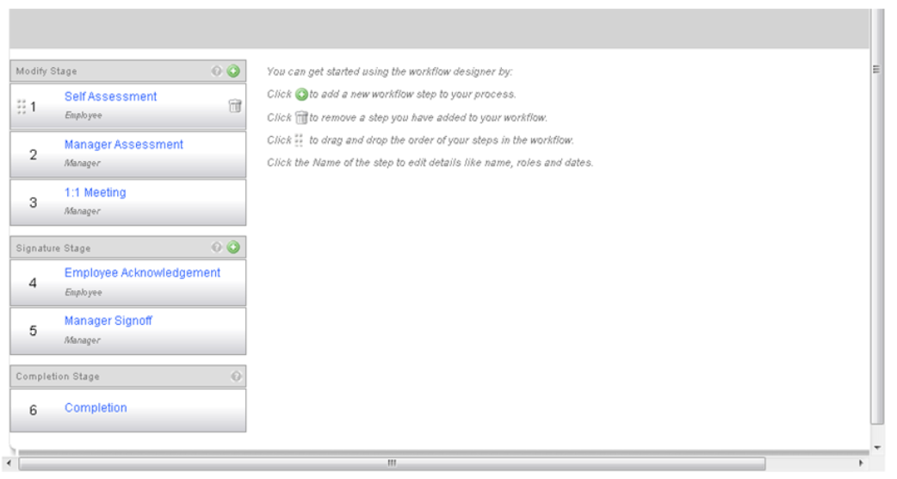
Stages of a Route Map

Slide 11
Steps of a Route Map in the Modify Stage
In the Modify Stage, you can edit the step name, step description, step type, reviewer roles, and dates.
The step name is the name that displays on the route map in a form. The step description is the description that the user sees in their To Do list on the Home page. This gives more context about the action users are being asked to take. If this field is left blank, the Step Name will be used for the To Do list.
Steps Types
The step type describes the way the form is routed.
Step Type | To Whom the Form is Assigned | Step Type Use
Single Role | Assigns the form to a single role or user. | This step type is used if you want only one user to have an assigned action in this part of the process.
Iterative | Assigns the form to a group of people. | This step type allows multiple users to send the form back and forth to each other before moving on to the next step. Users have a clear definition of who has the form in their inbox for editing and review, and who it will be routed to next.
Collaborative | Assigns the form to two or more users at the same time. | With this step type, the form is in the inbox of all the collaborative step participants at the same time. However, only one user can make edits at a time. If the form is being edited by one of the collaborative step participant or if it has not been closed using the Save & Close button and another participant tries to open the form, a lock out message will be presented to the user. The lockout period is 60 minutes.

Slide 12
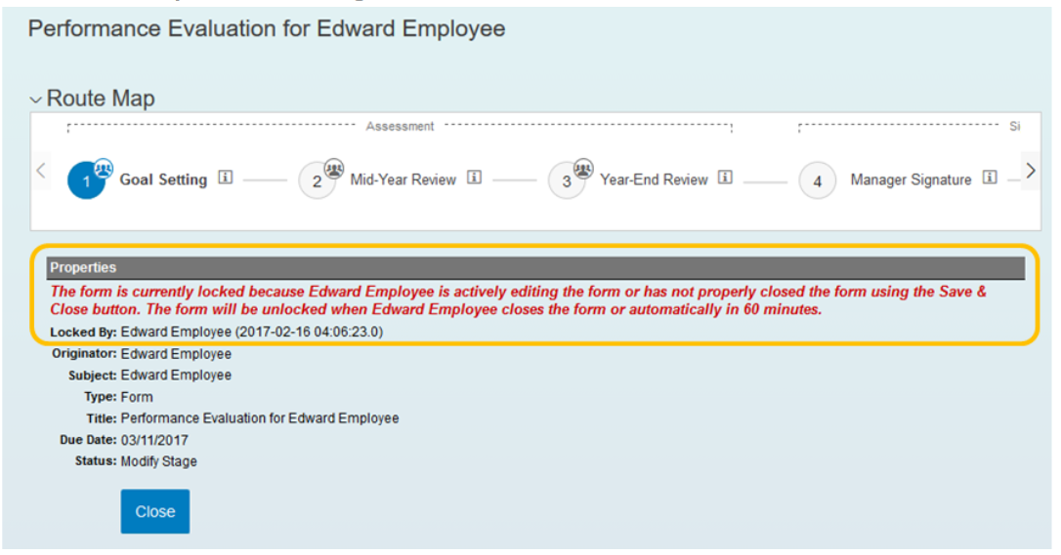
Collaborative Step Lockout Message

Slide 13
Reviewer Roles and Dates for Steps
Reviewer roles are associated with users when you add them to SAP SuccessFactors. The route map uses these roles to determine which users to send the form to. There are two Reviewer Roles, as follows:
Entry User: Specifies who receives the form first in an iterative step.
Exit User: Specifies who is assigned the form next in an iterative step or collaborative step.
Date fields can be defined in the route map to configure and control when the form moves from one step to the next:
Start Date: The date when the specific step starts.
Exit Date: The date before which the step cannot be completed.
Due Date: The date the step is due to be completed.
In addition two date related options also exist in the same area where Start Dates, Exit Dates, and Due Dates are configured:
Enforce start date: This will lock the form in read-only mode until the enforced start date is reached.
This way, users won't be able to work on the step until the specified start date.
Automatic send on due date: This will automatically forward the form to the next step on the due date.
Additionally, if you want to only send forms that pass the form validation check, select Only send forms that pass validation. Forms that don’t pass validation aren’t automatically moved to the next step. To send all forms regardless of whether they pass validation, select Always send regardless of validation.

Slide 14
Steps of a Route Map in the Signature Stage
In the Signature Stage you can edit the step name, step description, step type, and dates.
The step type is different in the Signature Stage than in the Modify Stage. Because the form can only be with one user at a time for signature, the step type in the Signature Stage contains the role of the person who is to sign during this step.
In the Completion Stage you can edit the step name, and select carbon copy roles which determine the user(s) who receive a read-only copy of the form when it is completed.
Steps of a Route Map in the Completion Stage

Slide 15
Steps of a Route Map Advanced Options
In all route map steps, there is an option to Show advanced options..., but the available options vary by stage. For example, in the Modify Stage, there is a Step Mode option that can be used to restrict a step to allow comments only. This option is not available in the other stages because there is no option to add comments or make edits in the other stages.
All stages include advanced options for including various text messages for end users, but these also vary by stage. All steps allow you to configure Step Introduction and Mouseover text. Modify and Signature steps let you configure instructional text and button text. In addition, there is an option for a Step Exit Reminder that uses a rich text editor and gives administrators enhanced text editing capabilities (for example adding hyperlinks or bold text).

Slide 16
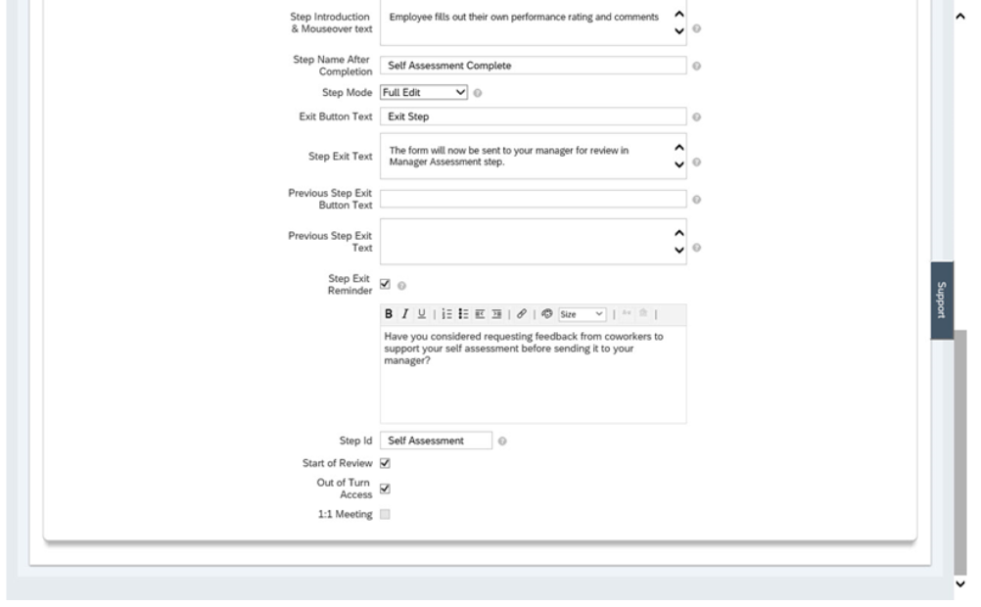
Step ID
The Step ID is the unique identifier of the step in the route map. This is used by consultants in configuring permissions on a form template through XML or via Manage Templates in Admin Center. The final step in the route map, usually called the Completion step, does not have a step ID. So permissions in a form template can only include this step if the particular permission is applied to all route map steps.
Step Advanced Options

Slide 17
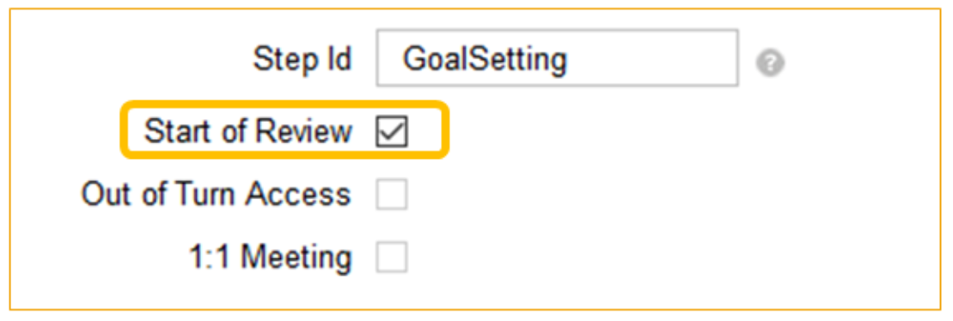
Start of Review
The Start of Review option identifies the beginning of the performance review process. This is generally set to the first step of the route map. The main function of this feature is to identify when a form is added to the “Team Overview” page. This ensures the Team Overview tab is made available to the direct managers and / or to the matrix or HR managers if they are involved in the workflow.
If you want managers to use the “Team Overview” page, you have to ensure that you have selected the “Start of Review” feature on a step in the route map (preferably the first step in the route map) of a form. The Team Overview can be permissioned for the manager’s role in RBP if the corresponding option in Provisioning (the back-end of the instance).

Slide 18
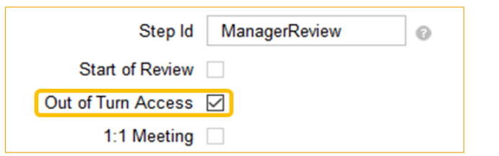
Out of Turn Access
The Out of Turn Access (OOTA) in Advanced Options allows roles to access a copy of the form via Team Overview before the form officially reaches them.
To use this option, Start of Review has to be activated either for the same step or for one of the steps before.
Out of Turn Access can also be used without losing draft data in cases of:
Collaborative (C) Route Map steps. This does not mean that we can enable the OOTA on a collaborative step but it means that the form can be accessed with OOTA when the current step is a collaborative step.
Manager and Matrix Manager changes made via Manage Users, Employee Import, and the old and new document transfer tool.
Routing a form using the Route Form tool in Admin Center.
Sending a form backwards using the Send Back button on the form.
When using Calibration where all forms are moved directly to the Calibration session, skipping in between steps.

Slide 19
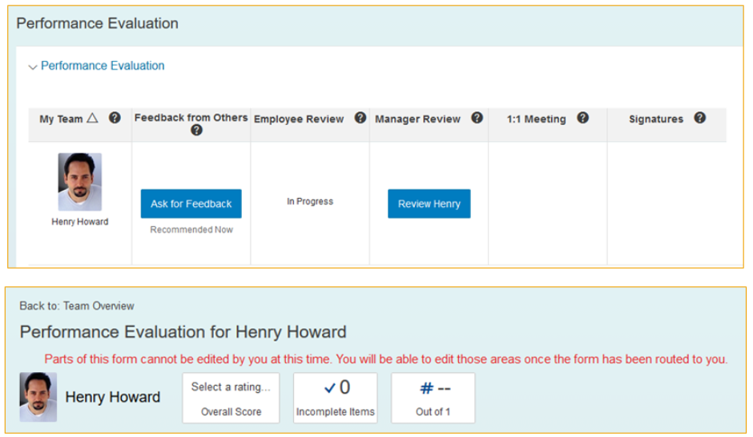
Out of Turn Access — End User View
In the example in this section, Edward’s form indicates that the Employee Review is still in-progress. Yet, Edward’s manager can still open the form from Team Overview. The manager will see a message at the top of the form with the following message: “Parts of this form cannot be edited by you at this time. You will be able to edit these areas once the form has been routed to you.”
If the OOTA feature is enabled, it is important to properly set permissions on the template to view ratings and comments at the intended steps for each role. For example, if other uses are not supposed to see the manager’s ratings and comments that are entered while using OOTA before a certain step, field permissions should be used to hide them before that step.

Slide 20
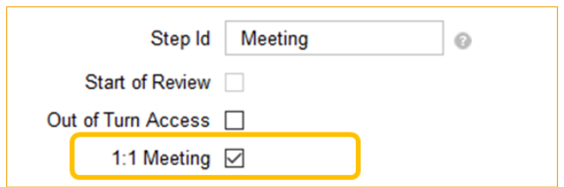
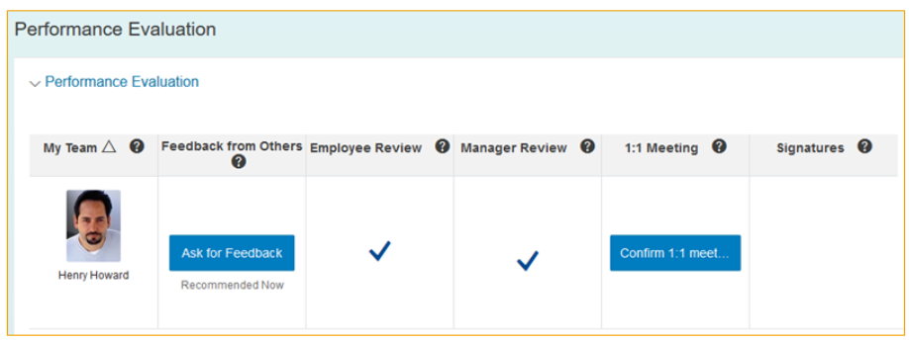
One to One Meeting
The 1:1 Meeting, as the name implies, is used when you have a 1:1 Meeting step created on the route map.
Only the last modifying step can be set as 1:1 meeting step. EM is the recommended role for 1:1 meeting.
A Confirm 1:1 Meeting button will appear on the Team Overview page for forms created after enabling this option in Manage Route maps. From the Team Overview, managers can click this button to route the form directly to the signature stage if it exists or to the completion stage, without having to open the form.

Slide 21
To Set Up a User-Defined Step in a Single Step Routemap
All performance review forms can be centralized in one account, by setting up a dummy user or technical user account. Several users from the Performance Management team can then proxy into this account. A User-Defined step in a Single-Step Route Map is frequently used for this purpose.
Steps
Add a single-role step to the route map.
Choose User from the dropdown menu of roles.
Results
A box appears, into which you can type the name of any user in the system to whom you want to grant access for this route step.
Type the name of the user you want to assign to the step.
Note: This option is only available for a single-role step type. In addition if the user assigned to the step leaves the company, you will need to edit the route map. It is therefore preferable to assign roles to route map steps rather than individual users.

Slide 22
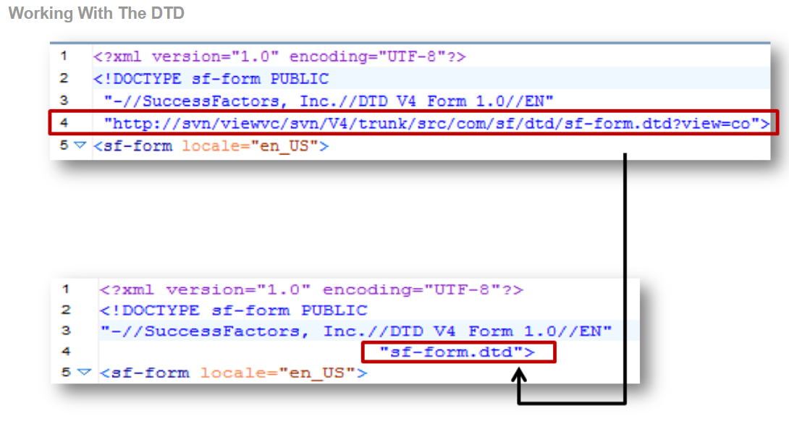
Working With the DTD

Slide 23
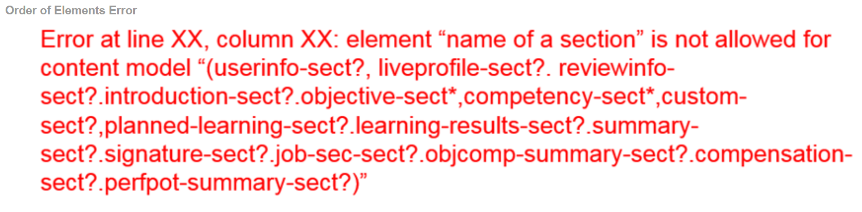
Order of Elements
The order of all the elements is very specific in the Performance Management XML template. One of the more common error messages from the XML editor looks like the following:
This message means that the elements are not in the correct order.
Note: Please download the ‘Order of Elements’ Excel spreadsheet from SAP Jam or the Learning Room. This document is extremely useful for sorting out the order in which sections should be listed, and especially where permissions must be added in each section.
Order of Elements Error:

Slide 24
Calibration in Performance Management
About This Module
Module Knowledge
Defining Calibration in the Performance Review Cycle
Calibrating Performance Forms
Configuring the Calibration Template
Configuring Calibration Sessions

Slide 25
Defining Calibration in the Performance Review Cycle
About This Topic
In this lesson, you learn about the benefits and various aspects of calibration, as well as how to use calibration tools.
Objective(s)
After completing this lesson, you will be able to:
Define calibration in the performance review cycle

Slide 26
Calibration in Performance Management (PM)
Calibration is the process organizations use to compare and adjust the ratings of their team to ensure performance levels are standardized across the organization. By using the calibration tool, managers can discuss how to apply similar performance standards for all employees and help eliminate any potential manager bias.
Benefits of Calibration
Calibration offers the following benefits to organizations:
It allows managers to view data for various teams and discuss selected ratings.
It offers managers the opportunity to bring “hard” and “easy” graders in line with their peers to improve the consistency and overall fairness of performance reviews.
It teaches managers to use the same language as one another, and to share understanding of competencies and expectations of employee behavior.
It allows facilitators to make changes to ratings based on the outcome of the calibration session.
It establishes a common and well-understood definition of performance across the company.

Slide 27
Tools and Metrics for Calibration
The following tools and metrics can be calibrated in SAP SuccessFactors if the customer purchased the corresponding module:
SAP SuccessFactors Performance Management:
Overall objective/goal rating
Overall competency rating
Overall performance review score
SAP SuccessFactions Succession
Talent Flags
Risk of Loss
Impact of Loss
Reason for Leaving
SAP SuccessFactors Compensation
Several ratings, including:
Compa-ratio
Range penetration
SAP SuccessFactors Employee Profile
Potential
Performance
Competency
Objective
Custom01
Custom02
Note: This course only covers the SAP SuccessFactors Calibration tool from a SAP SuccessFactors Performance Management perspective.

Slide 28
SAP Fiori Standards for Calibration
Various screens for different modules of SAP SuccessFactors have adopted SAP Fiori standards. Calibration is no exception and has also adopted these standards.
Note:
End of Maintenance / End of Life for Calibration Legacy UI
Calibration has adopted SAP Fiori standards in order to harmonize the UI with other SAP SuccessFactors modules. The End of Maintenance for the legacy Calibration User Interface (also referred to as the Calibration Legacy UI) was reached in Q3 of 2018. As a result, Fiori was pushed to all customers in Q3 2018 with the option to revert to the legacy Calibration UI. This revert option is being phased out and during Q3 of 2019 all customer instances using the older UI are being upgraded to the new UI.
Please visit the Calibration section of the SAP SuccessFactors Community at https://community.successfactors.com/t5/Calibration/ct-p/Calibration for further details.
End of Maintenance / End of Life for Calibration Legacy UI: Calibration Org Chart
Starting from Q4 2019, no more maintenance will be performed on the the Calibration v11 Org Chart. Functional enhancements will only be made to the Calibration v12 Org Chart. With the Q2 2020 release SAP SuccessFactors will automatically activate the Calibration v12 Org Chart for all those customers who have not yet enabled it.
Please visit the Calibration section of the SAP SuccessFactors Community at https://community.successfactors.com/t5/Calibration/ct-p/Calibration for further details.

Slide 29
Calibration Concepts
Calibration is a step within the performance review process. There are some adjustments you might need to make to the performance review template and the route map before you launch the review process. To make these adjustments, it is important to have an understanding of the basic calibration concepts.
Roles and Responsibilities
The calibration tool uses roles to assign different responsibilities to various users in the calibration process.

Slide 30
Roles and Responsibilities in Calibration
Different users have different roles and responsibilities in the calibration process, as follows:
Role | Responsibility
Facilitator | Facilitate the session. This is typically a HR representative. The facilitator is a neutral person responsible for managing the session and ensuring that the information required to calibrate employee ratings is available. They have access to read and edit the session, but do not necessarily have subjects in the session.
Subject | The subject is the employee whose ratings are being calibrated.
Participant | The participant is the manager of the subjects being calibrated (EM). Participants other than the owner’s direct reports can also be selected to participate in the session.
Owner | The owner is the manager of the participant (EMM). The owner’s direct reports are automatically made participants in the session, and the direct reports of the participants are automatically made subjects. The owner ensures that all managers reporting to them use the same metrics for rating their team members. This ensures that ratings and compensation decisions (where applicable) are fair, consistent, and match company standards.
Executive Reviewer | A business or HR executive who does not necessarily have to be present for each Calibration session, but rather needs blanket access to the data across all sessions for a given Calibration template used in a talent management cycle. Users who are assigned this role get direct access to the sessions as well as the Executive Review summary page.

Slide 31
Calibration Template
A calibration template defines the dates, roles, and forms for a calibration session. The same calibration template can be applied to multiple sessions. Clients can choose to have just one calibration template that they use for the entire calibration process, or they can choose to create multiple calibration templates.
Calibration Session
A calibration session defines the applicable timeline, as well as the owners, participants, and subjects of the session. SAP SuccessFactors supports multiple active sessions.
Clients can also edit sessions they have already created. If they have already activated the session, however, they need to deactivate it to make the changes. After the changes have been made, the client can then reactivate the session.
Note: It is now possible to export sessions with more than 1000 subjects.

Slide 32
Calibration Views
Calibration views provide users an at-a-glance overview of relevant performance management information. This information is sorted into the following categories:
Dashboard view provides a high-level overview of the calibration session
List view lists all the employees in the calibration session
Calibration view provides users an at-a-glance overview of the following information:
Bin views display employees by ratings distribution. You must enable Manual Overall Rating for this to work.
Matrix view graphically displays employees on a matrix grid report, based on data selections made during calibration setup.

Slide 33
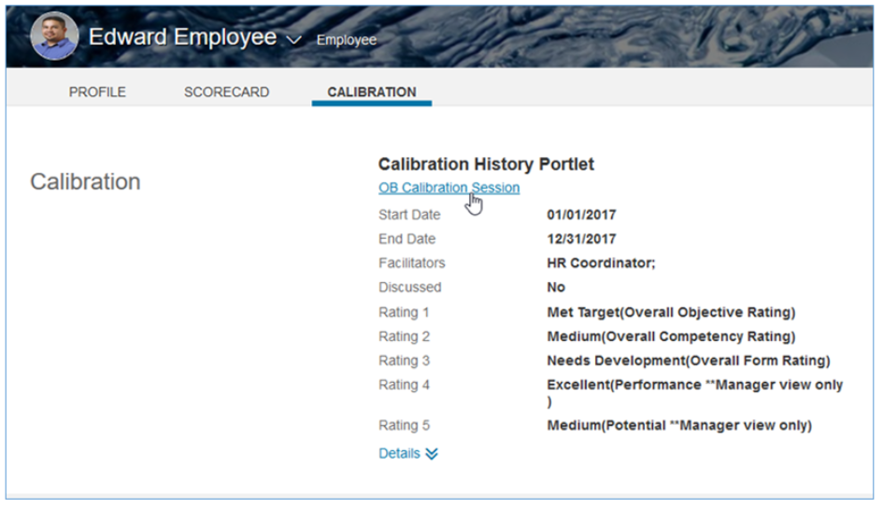
Calibration History Portlet
The Calibration History Portlet can be configured to display on the profile. This portlet will display up to five rating types from Calibration sessions. The items that display are configured within the Calibration template.
This feature is optional, and requires customers to upgrade to the v12 User Interface.

Slide 34
Adding the Calibration History Portlet
Go to the Success Data Model and verify that the background element id=”calibrationHistoryPortlet” is present. If it is not in the data model, the piece of code visible in the screenshot below will have to be added in the background elements.
<back-ground element id="calibrationHistoryPortlet" type-id="138".
<label>Calibration History Portlet</label>
</background-element>

Slide 35
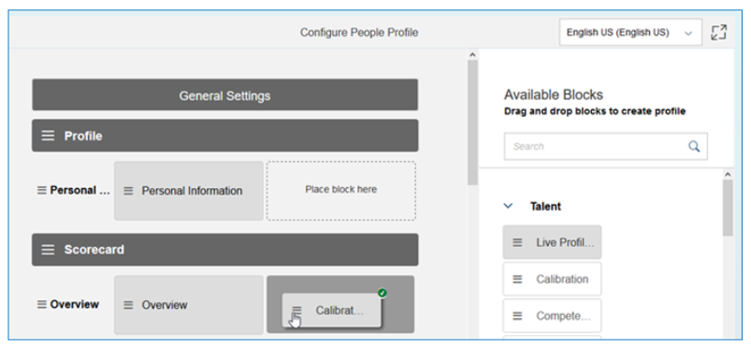
Adding the Calibration History Portlet
2. Navigate to Admin Center → Employee Files → Configure People Profile and drag and drop the Calibration block from the available blocks on the right hand side to where it should be placed for the end users on the left hand side.
There are several configuration options. You can define a portlet title, a portlet description, reorder fields, and add the Facilitator and Discussed column. Save your changes with the Save button at the bottom of the Configure People Profile Page.

Slide 36
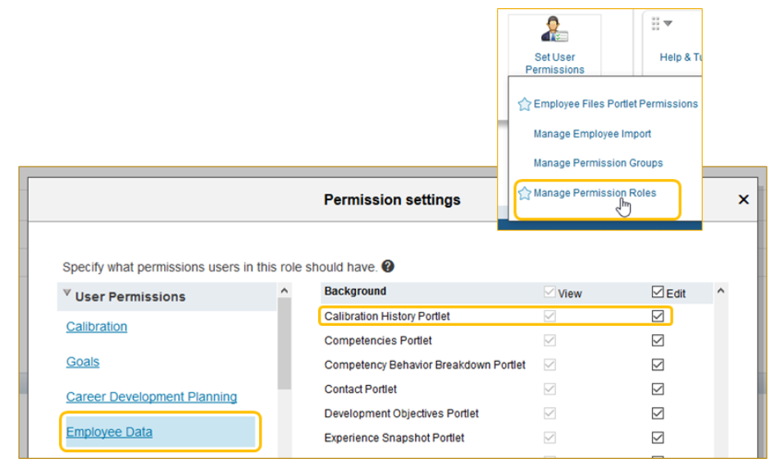
Adding the Calibration History Portlet
3. Navigate to Admin Center → Manage Permission Roles and select the role(s) that should be able to see the portlet in Employee Profile. Select Permissions under Employee Data and select Calibration History Portlet. Then select Done and save the changes.

Slide 37
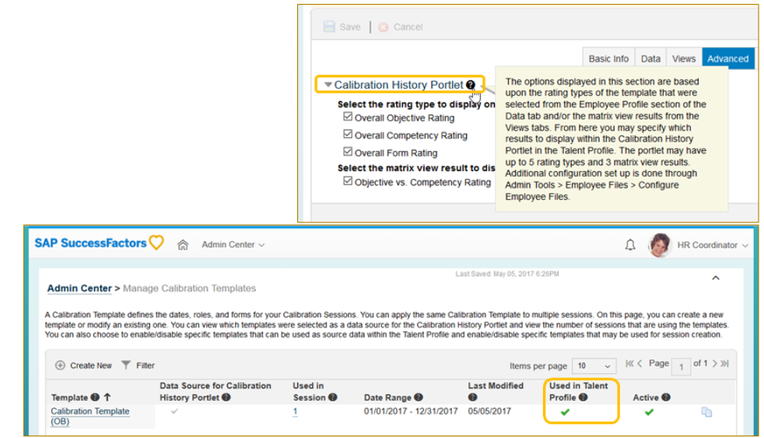
Adding the Calibration History Portlet
4. Navigate to Admin Center → Manage Calibration Templates Make sure the Used in Talent Profile is enabled for the calibration template that has to send the ratings in the Calibration History Portlet.
While still in Manage Calibration Templates go to the Advanced tab and make sure that the necessary options for the Calibration History Portlet are selected.

Slide 38
Calibration Tools
Users with permissions to see the calibration tab will be able to access the calibration tool once you have executed the following actions:
Grant permissions
Assign roles
Create templates
Calibrate and activate the session
By default, the user starts off viewing the dashboards. Here they can see an overview of the desired rating distribution compared to the actual rating distribution. A Goal vs. Competency (or obj/comp 9–box) tab is also available to be configured in the calibration template. This tool allows users to visually identify where each user falls when weighing competencies over goals, or vice versa.
Calibration includes the ability to generate multiple Ad Hoc Reports. If the user has permission, they can use the Ad Hoc Report Builder to generate calibration reports.

Slide 39
To Use Calibration Tools
Steps
Log into your SAP SuccessFactors account.
Results
If you are a participant of a calibration session, the menu shows that you have access to the calibration tool.
To see which calibration sessions you are a participant in, click the calibration tool.
To begin a calibration session, click the session name.
To access the bin view, click the Overall Rating tab.
Results
Here you can see where each subject falls in each bin. Based on the guidelines set up in the template, the calibration tool suggests how many subjects should be added or removed from each bin.
If the manual overall rating is enabled, drag and drop subjects between the bins. If only the calculated overall rating is enabled, move subjects between bins by clicking the button to the right of the subject’s name to open their performance review, and changing the relevant setting there.
To analyze subject ratings, choose the subject and click the Analyze button.
Results
A “Stack Ranker” style view displays.
If the manual overall rating is enabled, click the appropriate number on the Analyze screen to edit the ratings. If only the calculated overall rating is enabled, edit the ratings by opening the relevant performance forms.
When the analysis is complete, click Save to close the tool.
Click Finalize to complete the calibration.

Slide 40
Calibrating Performance Forms
About This Topic
This lesson shows you how to configure and enable calibration, how to grant calibration permissions, and how to create a calibration route map.
Objective(s)
After completing this lesson, you will be able to:
Configure calibration in Provisioning
Grant calibration permissions
Describe the creation of a calibration route map

Slide 41
Calibration Requirements
Before calibration can be used with Performance Management forms, the following requirements must be met:
The route map must have at least one edit step for calibration, which is not iterative.
You must configure manual ratings in performance forms for Performance, Potential, Overall Objective, or Overall Competency to use the drag and drop option in calibration.
You must associate a valid rating scale with these ratings.

Slide 42
Calibration Enablement
Several options are available in Provisioning that allow you to tailor the application to meet the customer’s requirements. To use calibration in the SAP SuccessFactors application, you must enable it in Provisioning. The Enable Calibration option in Company Settings is used to enable calibration.
You can also enable the following options in Provisioning according to customer requirements:
Limit Employee to be included in only one calibration session at a time
Enable Calibration Executive Review
Enable Manager Calibration Session
Enable Reverse Scale
Enable Enforce Comment Option In Views
Show In-Progress Calibration Ratings In Live Profile
Launch Calibration From PM v12 Team Overview
Enable External Summary Link - Currently Siemens Only Feature
Enable Calibration V12 Org Chart
Enable Fiori Restyling for Calibration
The following options are not necessary for the calibration tool to work properly:
Calibration tool (9–box) [Demoable, Not Ready for Production] (requires Version 11 UI framework (ULTRA) )
Stack Ranker (requires Version 11 UI framework (ULTRA) ) [Not Ready for Sales/Production]

Slide 43
To Enable Calibration
Steps
Log in to Provisioning, and navigate to Company Settings.
Select Enable Calibration.
Review additional Calibration options to enable. Common options include Enable Calibration Executive Review, Enable Manager Calibration Session, Enable Enforce Comment Option in Views, Launch Calibration from PMv12 Team Overview, and Enable Fiori Restyling for Calibration.
Select the appropriate permission model radio button, according to the customer’s permission model (usually role-based permission model).
Scroll to the top of the screen and click Save.
Note:
Most of the available options in Provisioning under Enable Calibration can also be found in Admin Center → Calibration → Manage Calibration Settings → Global Settings.

Slide 44
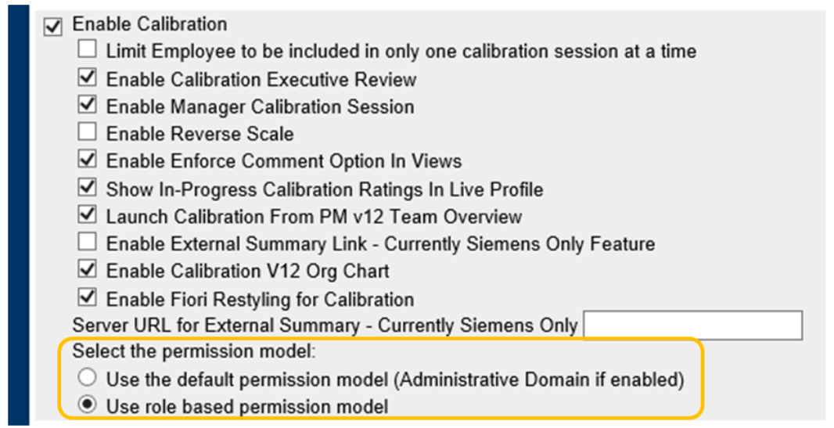
Definition of Calibration Permissions
Calibration can be used either with the legacy permission system (Administrative Domain) or with role-based permissions based on the permission system the customer uses in their instance. There are radio buttons in Provisioning to specify what has to be used for Calibration.

Slide 45
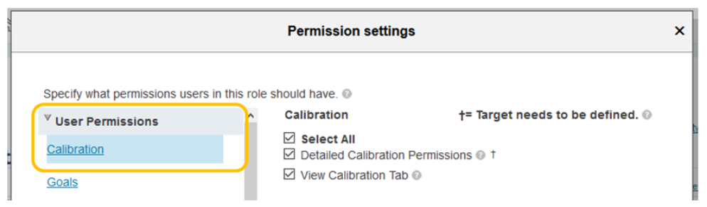
Calibration User Permissions
It is recommended to use the role-based permission model for Calibration. When it is selected, you can mmake the necessary modifications to the permissions by navigating to Admin Center → Set User Permissions → Manage Permission Roles → select a role → Permission....
There are Calibration permissions under User Permissions.

Slide 46
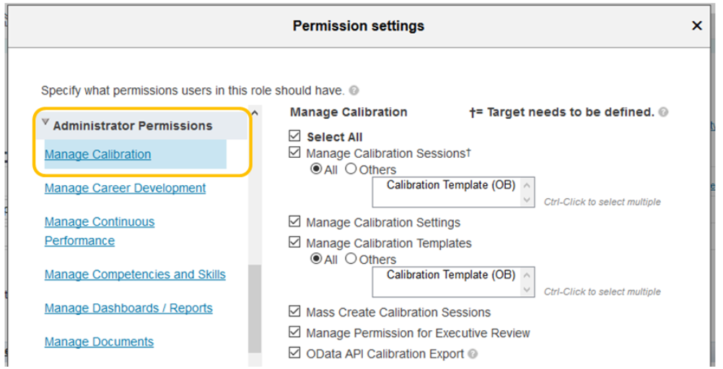
Calibration Administrator Permissions
There are also Calibration permissions under the Administrator Permissions.

Slide 47
Creation of a Calibration Route Map
For Calibration to work, you must designate a single-user step or a collaborative step in the performance review route map. When you set up the calibration template, you must confirm the step at which calibration will be completed. Iterative steps from the performance route maps cannot be selected in the Calibration template to answer this question: “At which routing step can the data be used?”

Slide 48
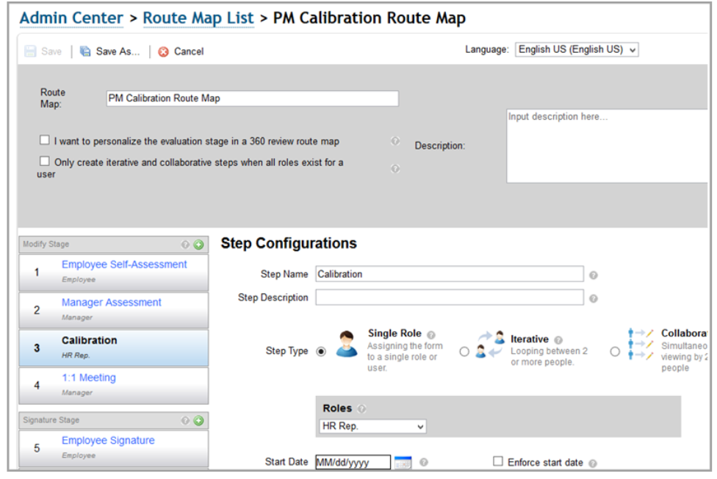
PM Calibration Route Map

Slide 49
Performance Management and Goal Management Integration
About This Module
Module Knowledge
Defining Integration in Performance and Goal Management
Defining the Goal Management and Performance Management Integration Process

Slide 50
Defining Integration in Performance and Goal Management
About This Topic
In this lesson, you will learn about the modules that integrate with the Goal Management product and the Performance Management product.
Objective(s)
After completing this lesson, you will be able to:
Define modules that integrate with the Goal Management and Performance Management products

Slide 51
Integration
You can link module applications to act as coordinated units. The links between module applications are either physical or functional. This module describes the integration data that you use in this process, and the functional touch points between the Performance and Goals module and other platforms and modules.
Goal Management Integration
Goal Management integrates with a variety of modules, as follows:
Performance Management
Continuous Performance Management
Goal Management (with ability to copy goals from another goal plan)
360 Degree Multi-Rater Review
Variable Pay
Employee Central
Onboarding
Platform
Workforce Analytics and Planning

Slide 52
Performance Management Integration
Performance Management integrates with a variety of modules, as follows:
Performance Management
Continuous Performance Management
Goal Management
Career Development Planning
Calibration
Workforce Analytics and Planning
Platform
Compensation and Variable Pay
360 Degree Multi-Rater Review
Employee Central

Slide 53
Employee Central Integration Enhancements
There are several integration points between SAP SuccessFactors Employee Central and Performance Management and Goal Management. Some of these integration aspects include:
When a new manager is created in Employee Central, Goal Management will automate a “To Do” for the manager on the home page providing information about the need to review their new team’s goal plan.
When an employee is approved for a leave of absence in Employee Central, Goal Management will automate a “To Do” for the manager and employee to adjust the employee's goals as needed.
When an employee enters a new position or moves to a different department, automatic form creation will occur based on changes that match defined rules in EC data. For example, the auto-creation of the performance form in Performance Management occurs when the effective date of the change has been reached.

Slide 54
Defining the Goal Management and Performance Management Integration Process
About This Topic
In this lesson, you will learn about the Goal Management and Performance Management process.
Objective(s)
After completing this lesson, you will be able to:
Define key integration points for Goal Management and Performance Management with other SAP SuccessFactors products
Define how data is integrated in Goal Management and Performance Management

Slide 55
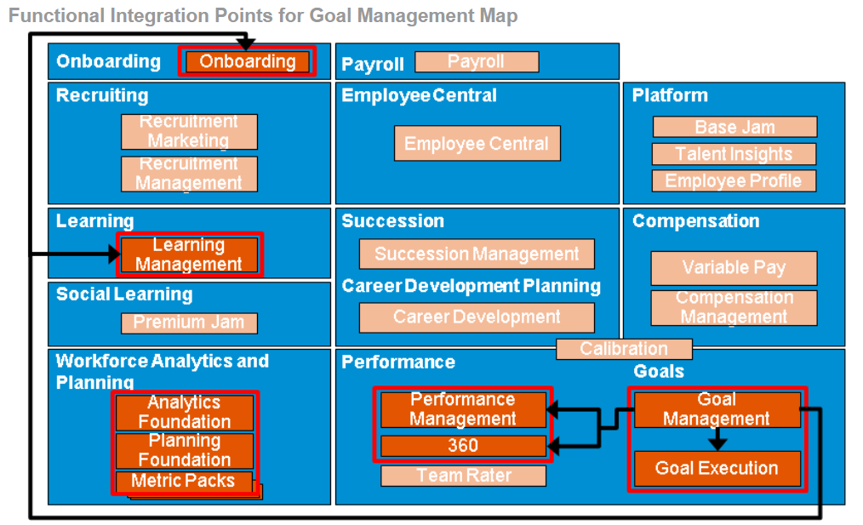
Functional Integration Points for Goal Management
There are touch points within each module where data is sourced and managed, as shown in the figure, Functional Integration Points for Goal Management Map.

Slide 56
Touch Points for Goal Management
There are a number of touch points for Goal Management, as follows:
Integration Point | Description
Performance & Goals | Within the module itself, Continuous Performance Management Achievements can be linked to goals and displayed on Goal Plans. Those goal plans, in turn, can display in the goal sections of Performance Management and 360 Multi-Rater forms.
Learning | Data populates Learning Management within the user’s LMS where users can assign relevant learning activities to meet goals.
Onboarding | Goal Management data can be used to assign goals within Onboarding where users can assign goals as part of employee’s onboarding and a 90–day outlook.
Platform | Data can be used in Employee Profile where users can view goal information via the goals portlet.
Workforce Analytics & Planning | Data can be sourced and manipulated in report output within Analytics Foundation, Planning Foundation, and Metric Packs.

Slide 57
Functional Integration Points for Performance Management
There are touch points within each module where data is sourced and managed, as shown in the figure, Functional Integration Points for Performance Management Map.
There are a number of touch points for Performance Management, as follows:
Integration Point | Description
Performance & Goals | Integration with Goal Management allows Performance Management to source data from goals plans into the Goal section of the form.
Career Development Planning | Performance Management derives data from CDP through integration. This data is sourced from the Development Goal Plan to populate the development goal section of the form.
Learning | Performance Management data is used to assign relevant learning activities to goals within a form section within the LMS.
Calibration | Data is used to calibrate performance and potential.
Workforce Analytics & Planning | Performance Management data can be sourced and manipulated in report output within Analytics Foundation, Planning Foundation, and Metric Packs.
Platform | Employee Profile, where users can view a goal, competency, performance and potential rating. You can display Employee Profile data in the Employee Information section of a Performance Management form.
Compensation & Variable Pay | Users can view performance data in compensation statements and bonus plans.

Slide 58
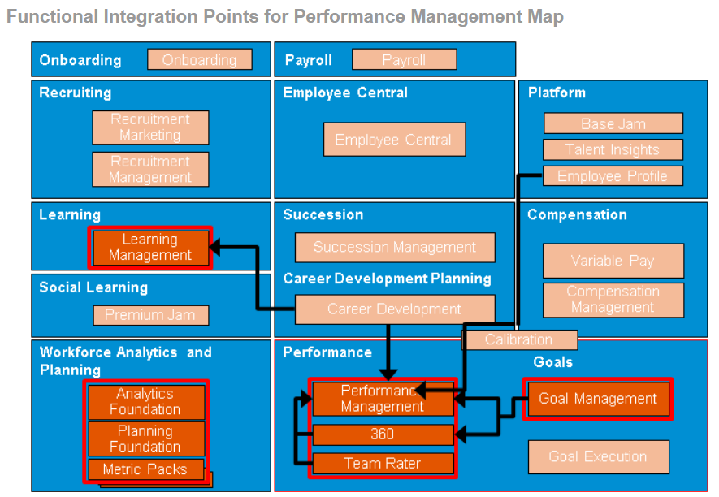
Functional Integration Points for Performance Management Map

Slide 59
Data Usage for Goal Management Integration
The following data supports Goal Management Integration:
Employee data populates the goal plan hierarchy and user fields.
You can manually import goal data into the goal plan, or you can integrate the data from a goal library to a goal plan.

Slide 60
Data Usage for Performance Management Integration
The following data supports Performance Management Integration:
Employee data populates the Employee Information section of the Performance Management form, and it provides the supporting hierarchy for the form workflow.
You use the data from Families, Roles, and Job Codes to measure the competency of an employee in their role.
Goal data populates the goal sections of the performance form. The data is sourced from goal plans.
Learning Activity data populates the goals section within the Learning Module.

Slide 61
Summary
In this lesson, you have learnt:
Record evaluations with rating scales in the performance form
Identify stages and steps within a route map
Identify roles to define Performance Management permissions
Access the Document Type Definition (DTD) and implementation guides
Explain the relevance of ‘order of elements’ within the Performance Management XML template
Define calibration in the performance review cycle
Configure calibration in Provisioning
Grant calibration permissions
Describe the creation of a calibration route map
Define modules that integrate with the Goal Management and Performance Management products
Define key integration points for Goal Management and Performance Management with other SAP SuccessFactors products
Define how data is integrated in Goal Management and Performance Management

